Slide 1
ATL Academy
ATL ACADEMY

Slide 2
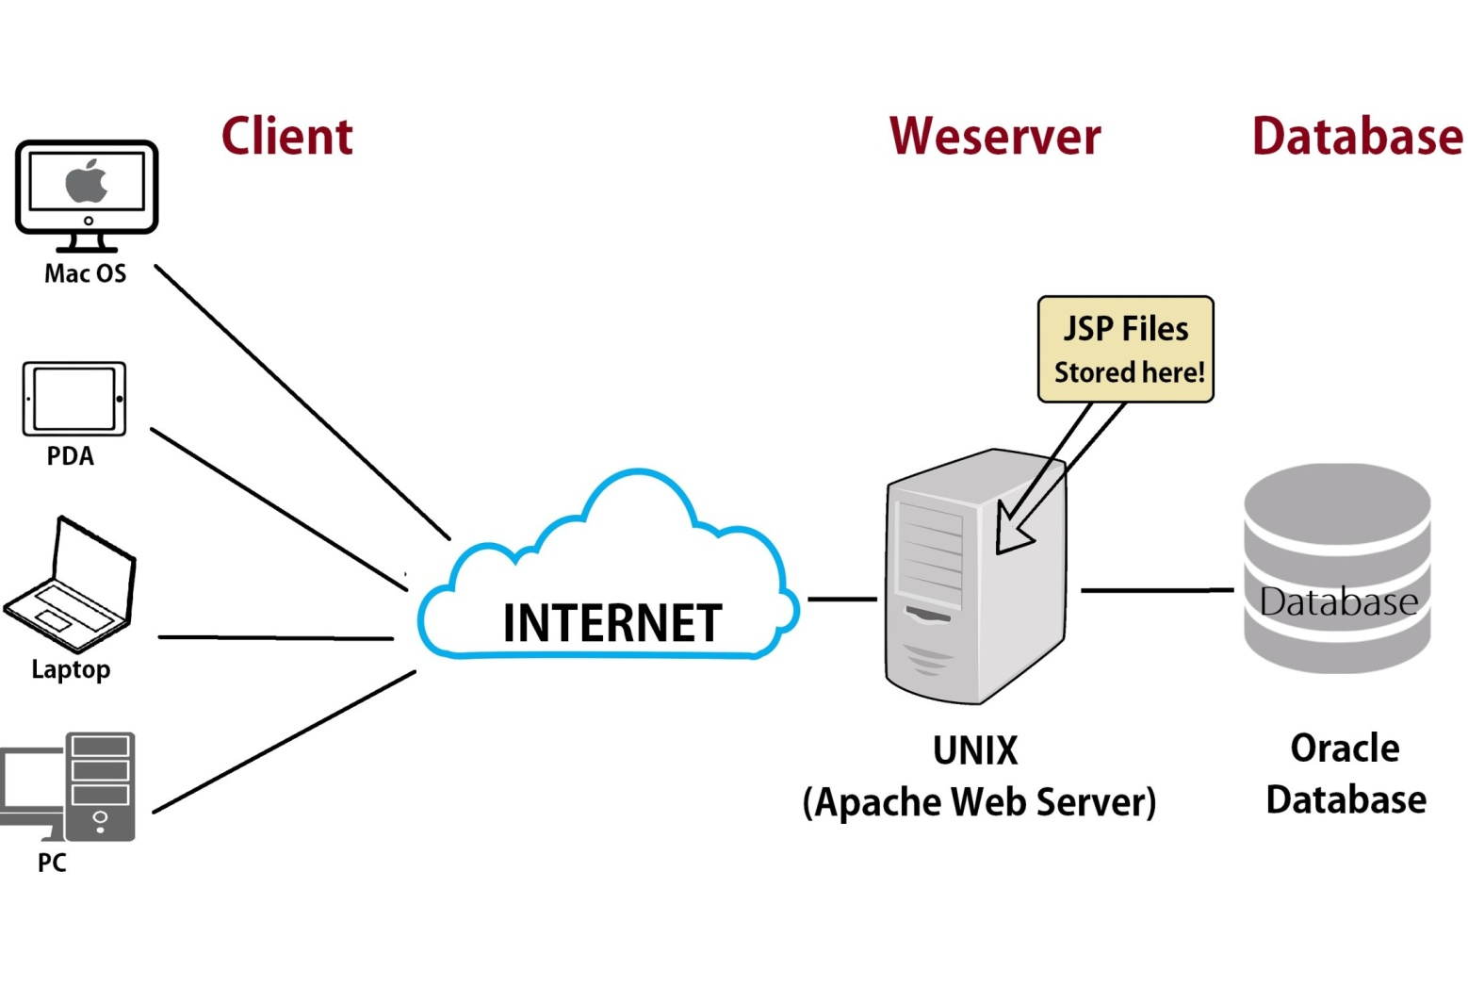
Introduction to web

Slide 3
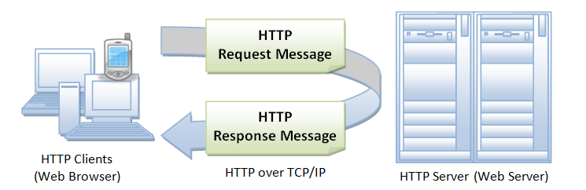
HTTP (HyperText Transfer Protocol)

Slide 4
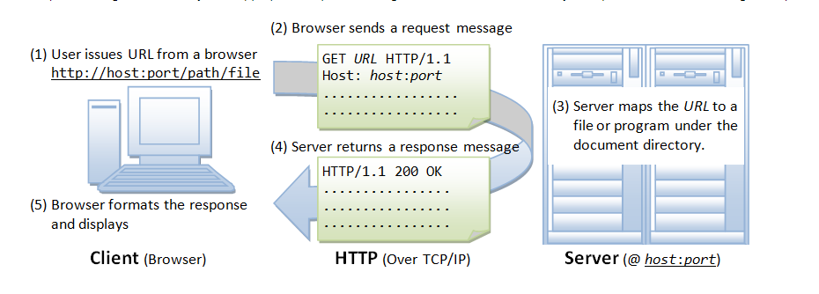
Browser

Slide 5
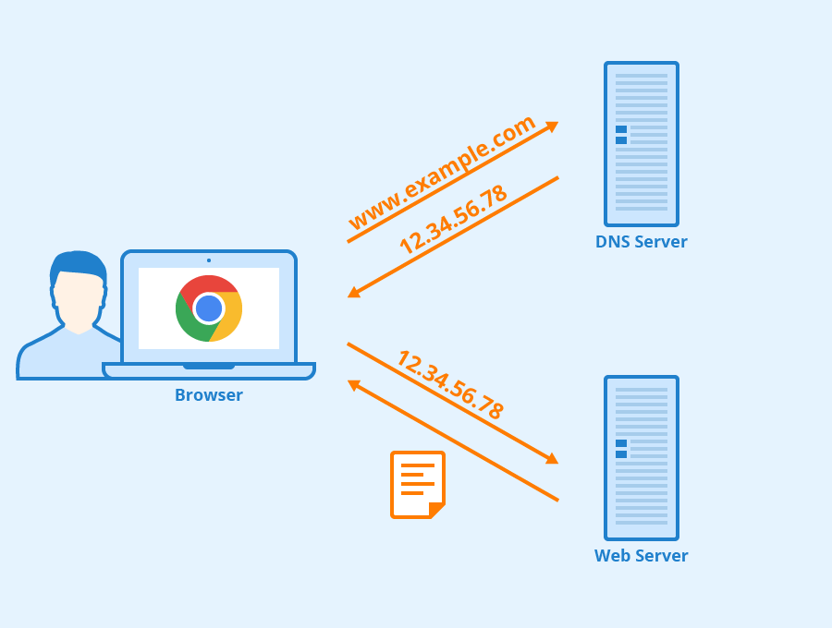
The Domain Name System (DNS)

Slide 6
Uniform Resource Locator (URL)
A URL (Uniform Resource Locator) is used to uniquely identify a resource over the web. URL has the following syntax:
protocol://hostname:port/path-and-file-name
http:80 https:443
Other examples of URL are:
ftp://www.ftp.org/docs/test.txt
mailto:user@test101.com
news:soc.culture.Singapore
telnet://www.nowhere123.com/

Slide 7
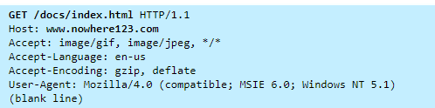
HTTP Protocol
For example, the browser translated the URL http://www.nowhere123.com/doc/index.html into the following request message:

Slide 8
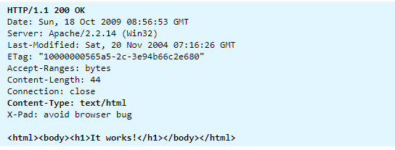
An example of the HTTP response message is as shown:
https://www3.ntu.edu.sg/home/ehchua/programming/webprogramming/HTTP_Basics.html

Slide 9
HTTP methods
HTTP protocol defines a set of request methods. A client can use one of these request methods to send a request message to an HTTP server. The methods are:
GET: A client can use the GET request to get a web resource from the server.
HEAD: A client can use the HEAD request to get the header that a GET request would have obtained. Since the header contains the last-modified date of the data, this can be used to check against the local cache copy.
POST: Used to post data up to the web server.
PUT: Ask the server to store the data.
DELETE: Ask the server to delete the data.
TRACE: Ask the server to return a diagnostic trace of the actions it takes.
OPTIONS: Ask the server to return the list of request methods it supports.
CONNECT: Used to tell a proxy to make a connection to another host and simply reply the content, without attempting to parse or cache it. This is often used to make SSL connection through the proxy.
https://www.w3.org/Protocols/rfc2616/rfc2616-sec9.html
https://www.guru99.com/difference-get-post-http.html

Slide 10
HTTP response status code
HTTP Status Codes
Informational 1xx
100 Continue. The client SHOULD continue with its request. ...
Successful 2xx
200 OK. The request has succeeded. ...
203 Non-Authoritative Information. ...
206 Partial Content. ...
Redirection 3xx
300 Multiple Choices. ...
Client Error 4xx
400 Bad Request.
404 not found
Server Error 5xx
501 Not Implemented
503 Service Unavailable
https://www.w3.org/Protocols/rfc2616/rfc2616-sec10.html

Slide 11
What is a Web Server?
A server is a computer that provides data to other computers. The entire structure of the Internet is based upon a client- server model.

Slide 12
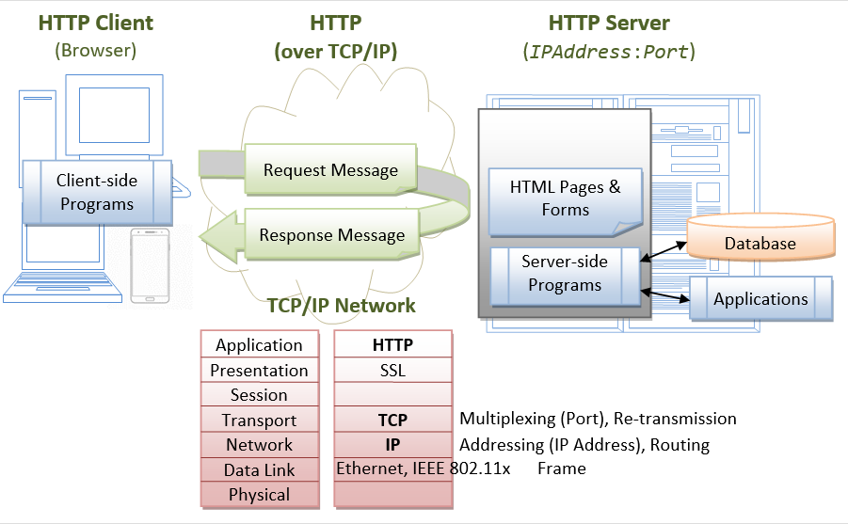
Java Servlets

Slide 13
Types of Servers
Mail Server: Mail Server provides a centrally-located pool of disk space for network users to store and share various documents in the form of emails. Since, all the data is stored in one location, administrators need only backup files from one computer.
Application Server: An application server acts as a set of components accessible to the software developer through an API defined by the platform itself. For Web applications. These components are usually performed in the same running environment as its web server(s), and their main job is to support the construction of dynamic pages.
File Transfer Protocol (FTP) Server: FTP uses separate control and data connections between the client and the server. FTP users may authenticate themselves in the form of a username and password. But can connect anonymously if the server is configured to allow it. For secure transmission username and password must be encrypted using FTP and SSL.
Database Server: A database server is a computer program that provides database services to other computer programs or computers using client-server functionality, and some DBMSs (e.g., Mysql) depend on the client-server model for database access. Such a server is accessed either through a “front end” running on the user’s computer where the request is made or the “back end” where the request is served such as data analysis and storage.
Domain Name System (DNS) Server: A name server is a computer server that hosts a network service for providing responses to queries. It maps a numeric identification or addressing component. This service is performed by the server in response to a network service protocol request.

Slide 14
Java Server Software:
Apache Tomcat
Jetty
Apache TomEE
Oracle WebLogic
WebSphere
WildFly
Apache Geronimo
GlassFish
Jboss
Link:https://www.baeldung.com/java-servers

